Slide 1
Airline Reservation System
JAVA
Advanced Java Programming(3160707) Project Work

Slide 2
TABLE OF CONTENTS
01
04
Introduction
Now vs Future
02
05
Our Team
Screen Shots
03
Technical Specifications
Introduction of our Advanced Java Programming Project Work
Problems of conventional system over our new system points
Introduction to Our Project Team Members
Some Screen Sneak Peak of our system
Software and Hardware Specifications

Slide 3
Introduction
Airline Reservation System basically an interaction between Admin and Client easily through web. This project describes how to creates Interaction between clients to manage the reservation. This project contain only one categories namely ADMIN, through which client can easily interact with admin .
Business Impact
This project can be very easily used in the process of various purposes in reservation of ticket of various airline. User can select between source and destination. User can view the status of airline, view the seat of airline. Admin can also view user list. The definition of our problem lies in manual system and a fully automated system.
Manual System
The system is very time consuming and lazy. This system is more prone to errors and sometimes the approach to various problems is unstructured.

Slide 4
Technical Specifications
Software Specification
Tool: NetBeans
Front-End: HTML, CSS
Back-End: Java, JSP, Servlet, MySQL
Hardware Minimum Specification
Operating System: Windows 7
Processor: Core i3
Memory: 4 GB RAM
Hard Disk: 500 GB

Slide 5
NOW
TIME CONSUMING AND LAZY
MORE PRONE TO ERRORS
UNSTRUCTURED APPROACH

Slide 6
FUTURE
BRANDING
SAVE – TIME & MONEY
AUTOMATED SYSTEM

Slide 7
SCREENSHOTS

Slide 8
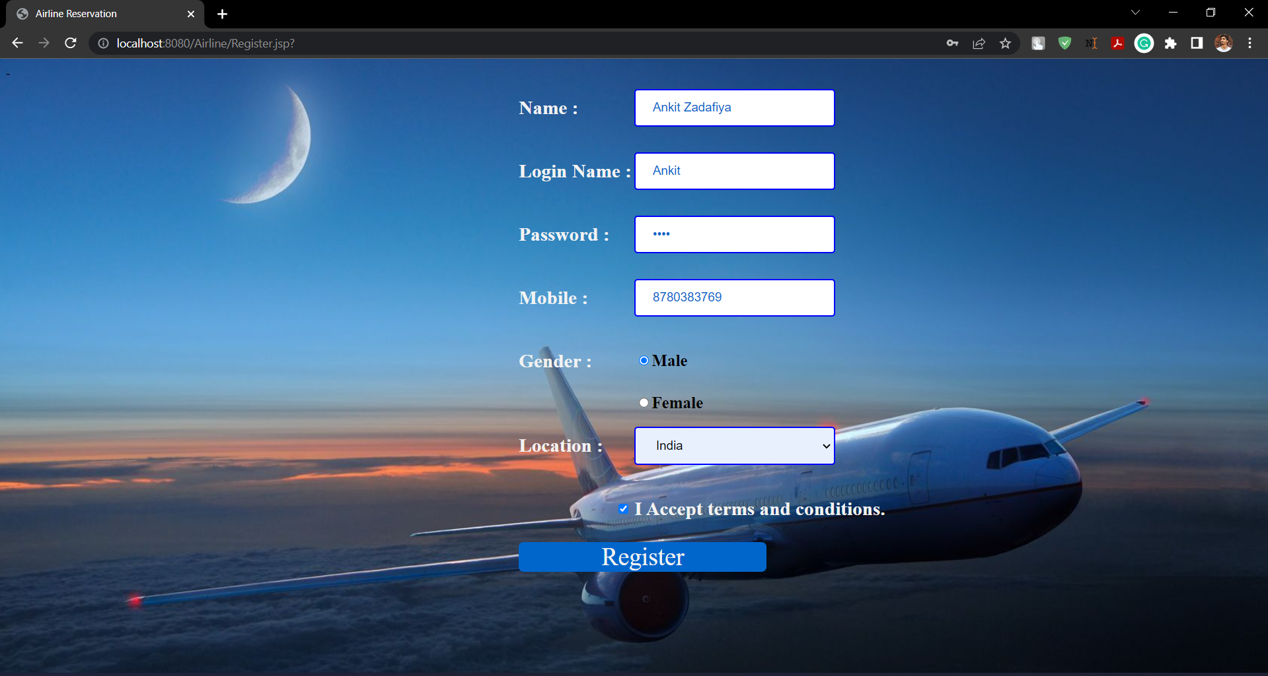
Register

Slide 9
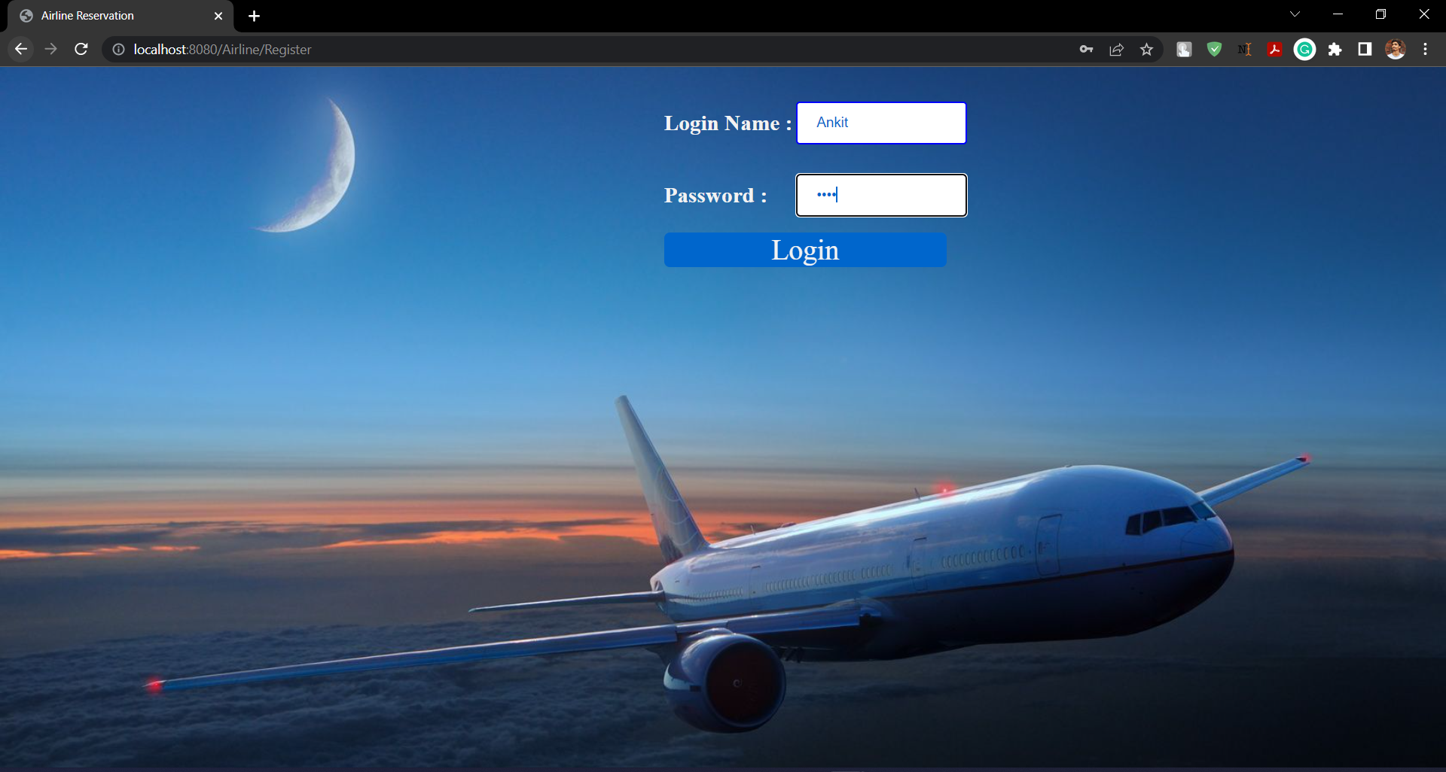
Login

Slide 10
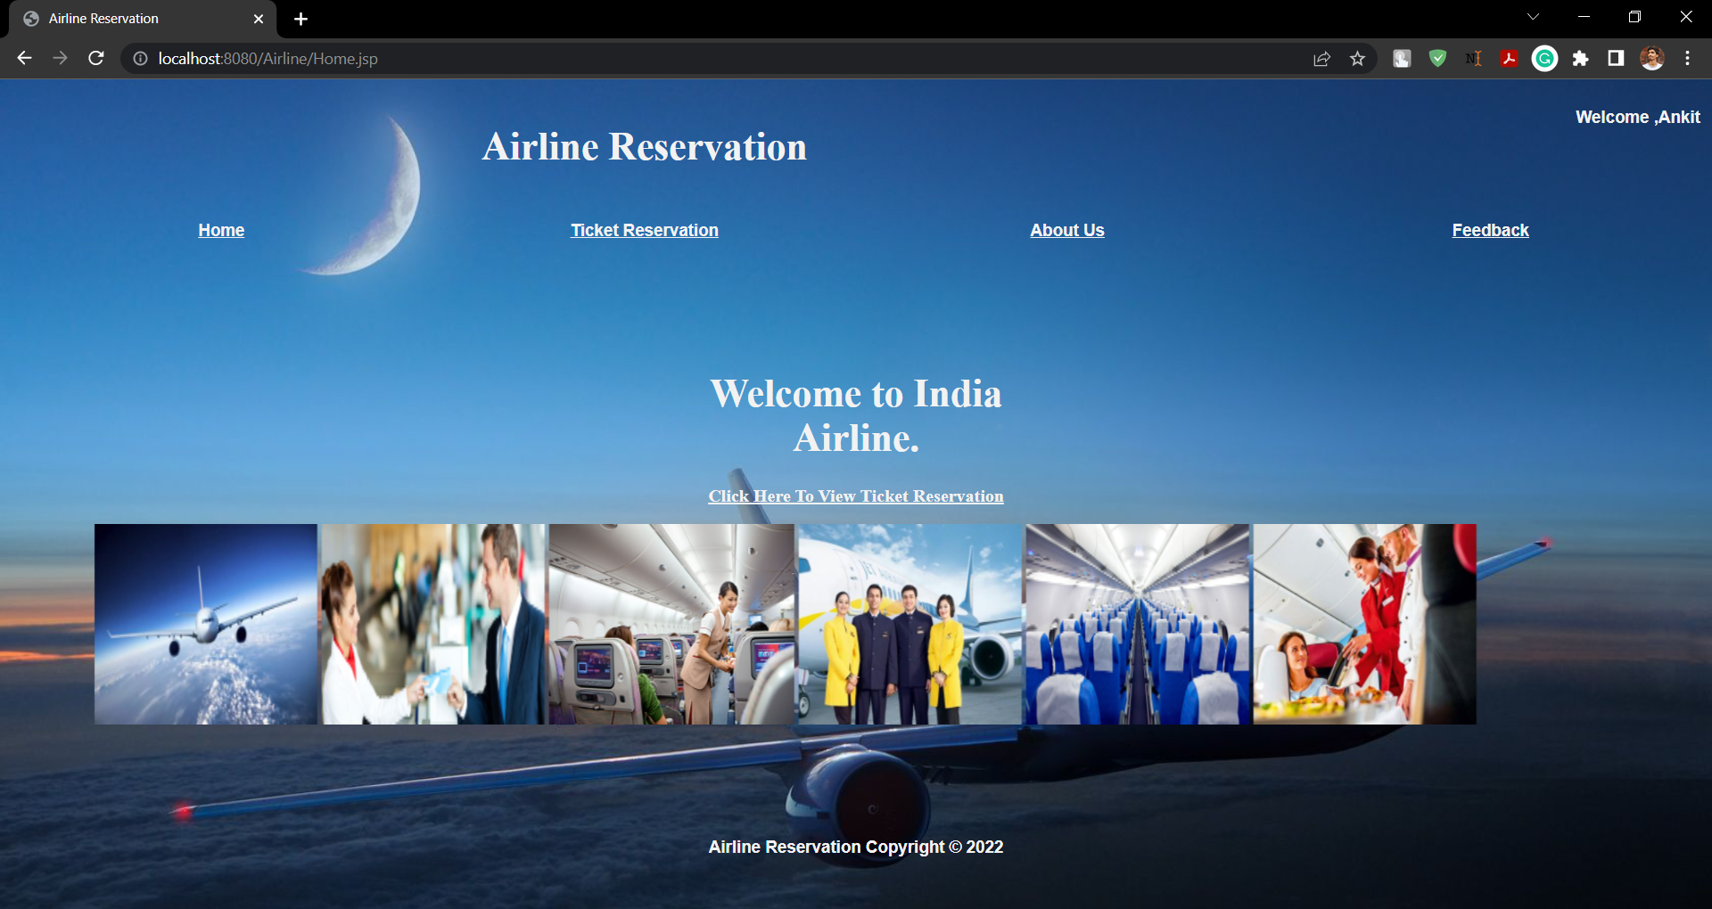
Home

Slide 11
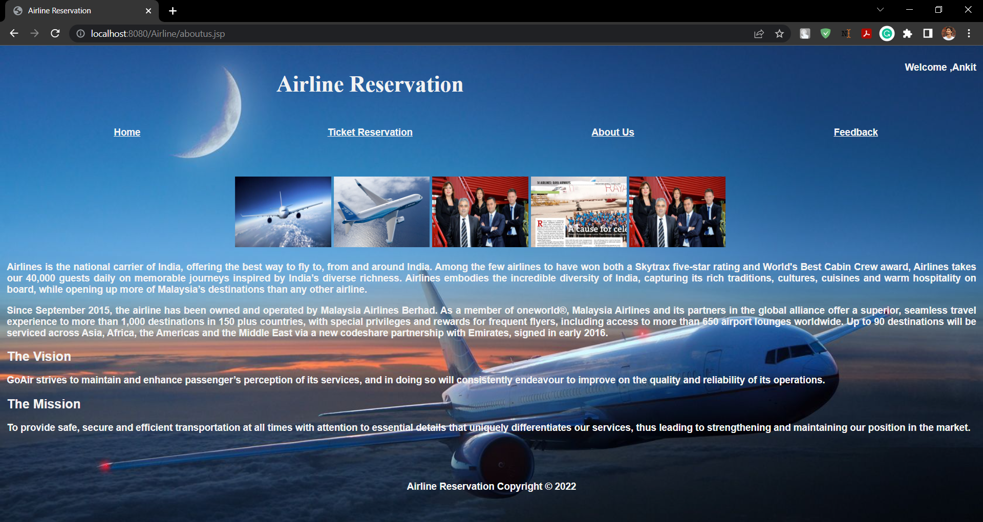
About Us

Slide 12
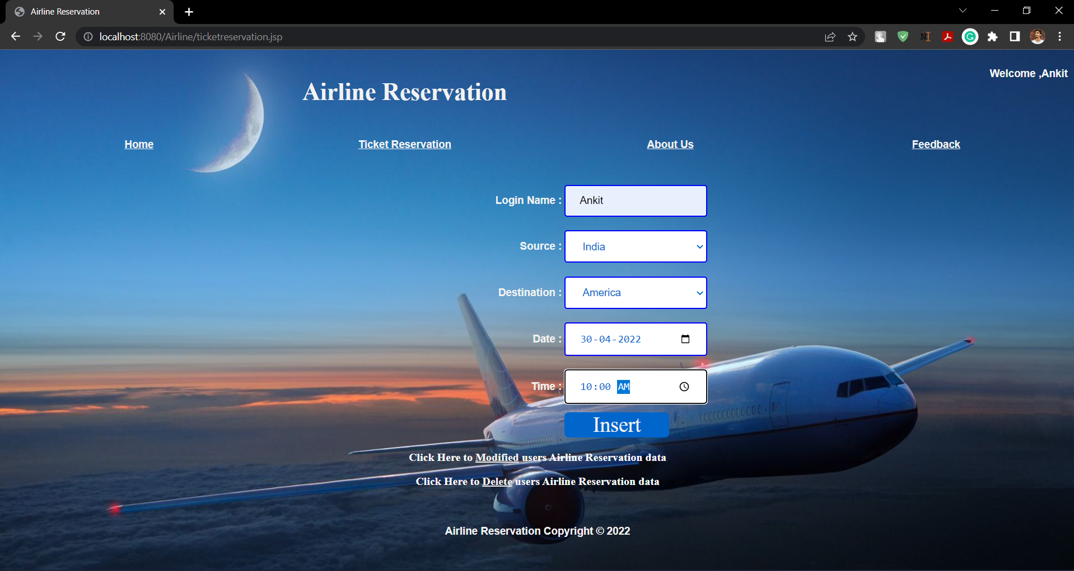
Ticket Reservation

Slide 13
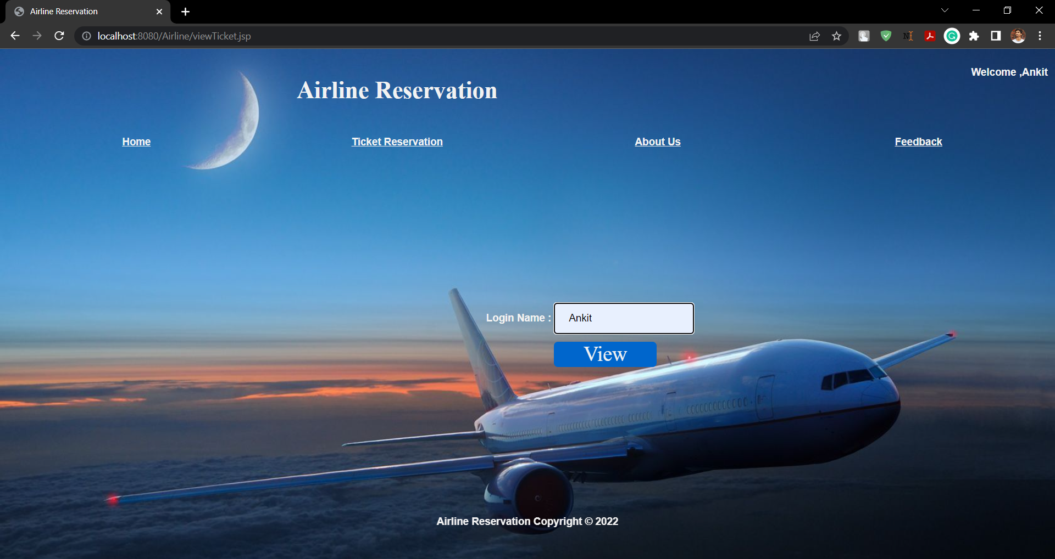
Viewing Reservation

Slide 14
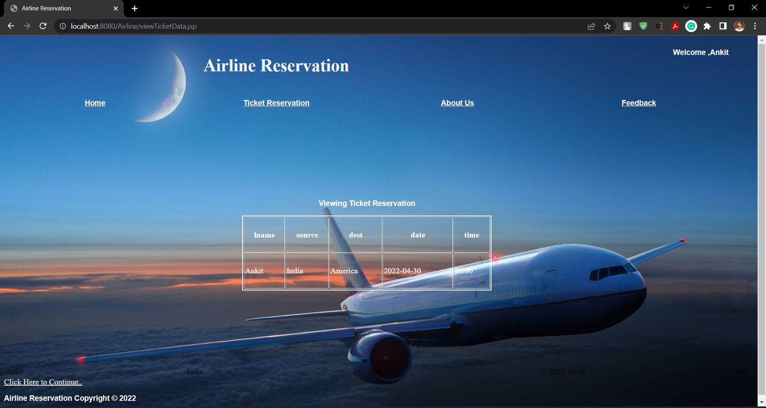
Viewing Reservation

Slide 15
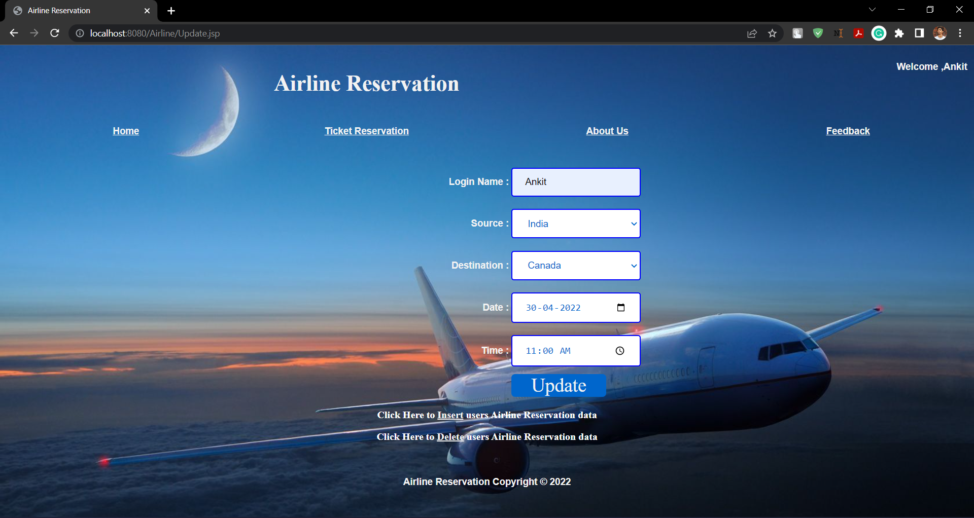
Updating Reservation

Slide 16
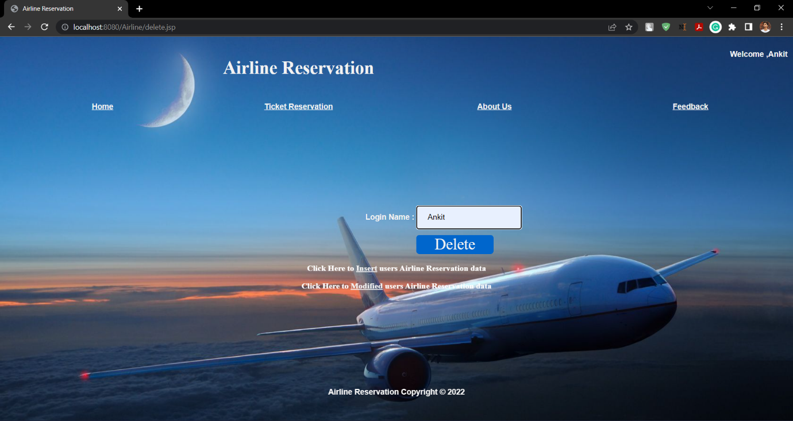
Deleting Reservation

Slide 17
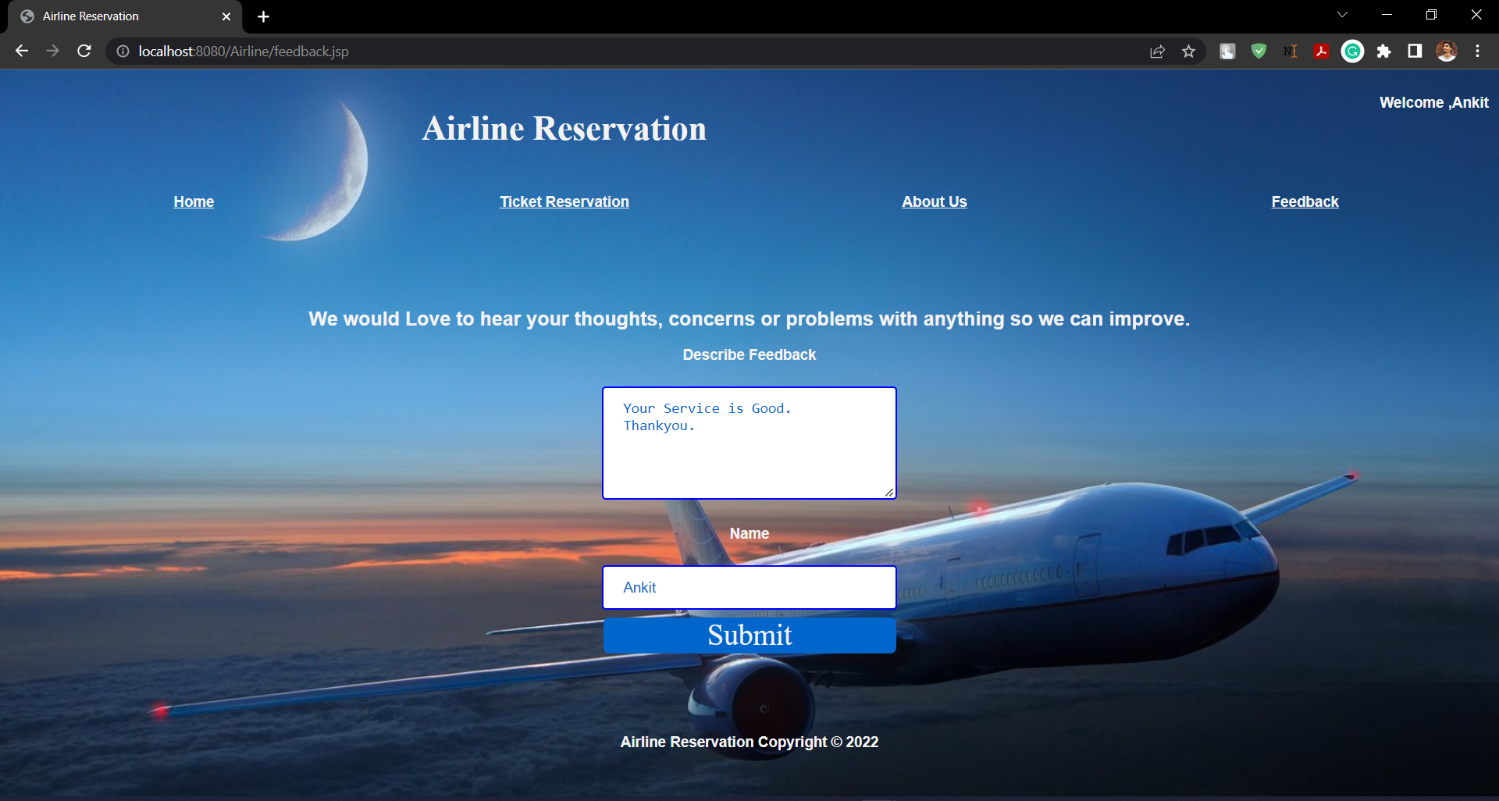
Feedback

Slide 18

THANK YOU!
JAVA

